Slide 1



Partial Orders
Partial Ordered Sets
A relation R on set A is called a partial ordering or partial order if it is reflexive, anti-symmetric and transitive.
A set A together with a partial ordering R is called a partially ordered set or poset. The poset is denoted as (S,R)

Slide 2
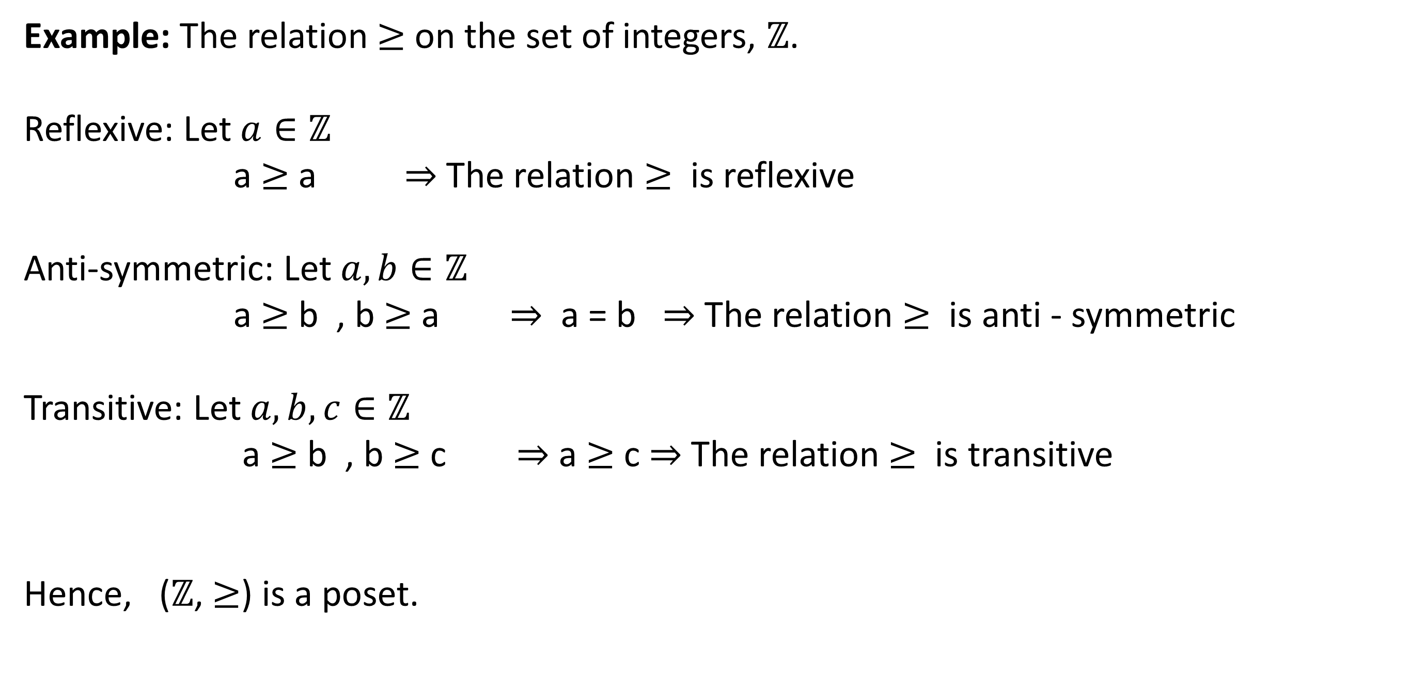
Example: The relation $≥$ on the set of integers, $ℤ$.
Reflexive: Let $a∈ℤ$
a $≥$ a $⇒$The relation $≥$ is reflexive
Anti-symmetric: Let $a, b∈ℤ$
a $≥$ b , b $≥$ a $⇒$ a = b $⇒$The relation $≥$ is anti - symmetric
Transitive: Let $a,b,c∈ℤ$
a $≥$ b , b $≥$ c $⇒$ a $≥$ c $⇒$The relation $≥$ is transitive
Hence, ($ℤ$, $≥$) is a poset.

Slide 3
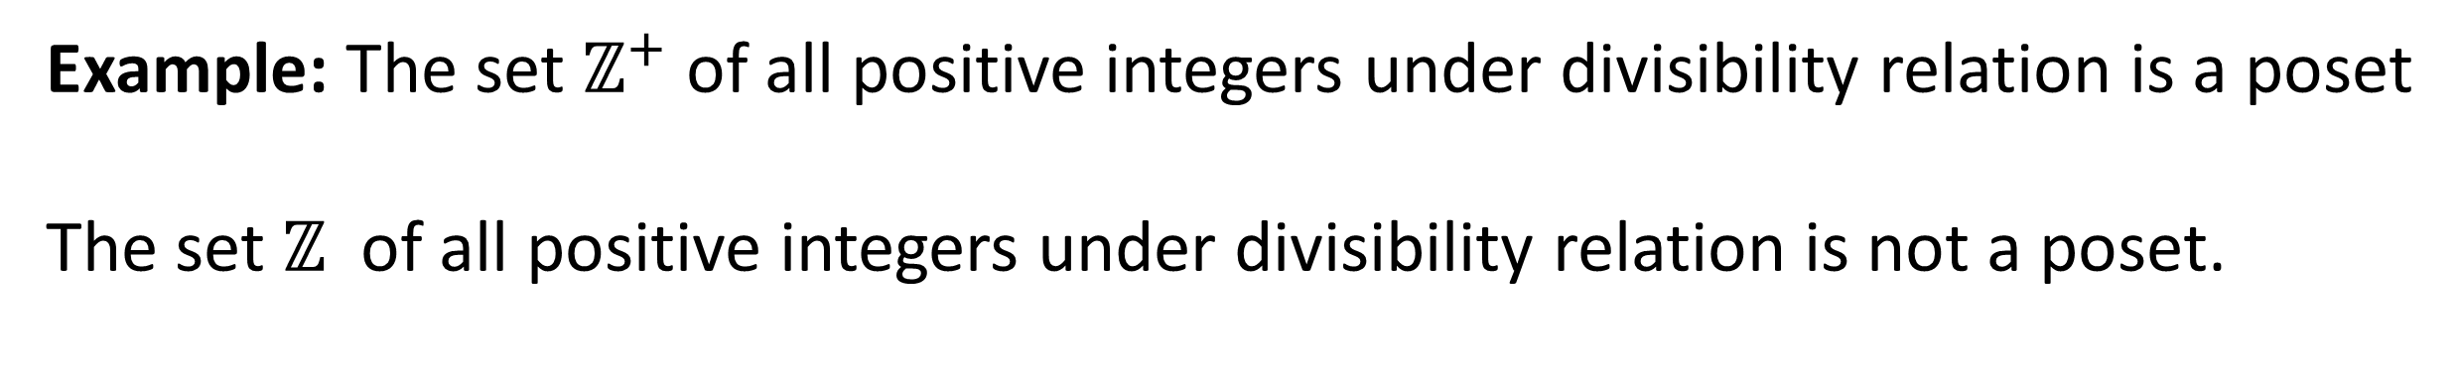
Example: The set $ℤ^{+}$ of all positive integers under divisibility relation is a poset
The set $ℤ$ of all positive integers under divisibility relation is not a poset.

Slide 4
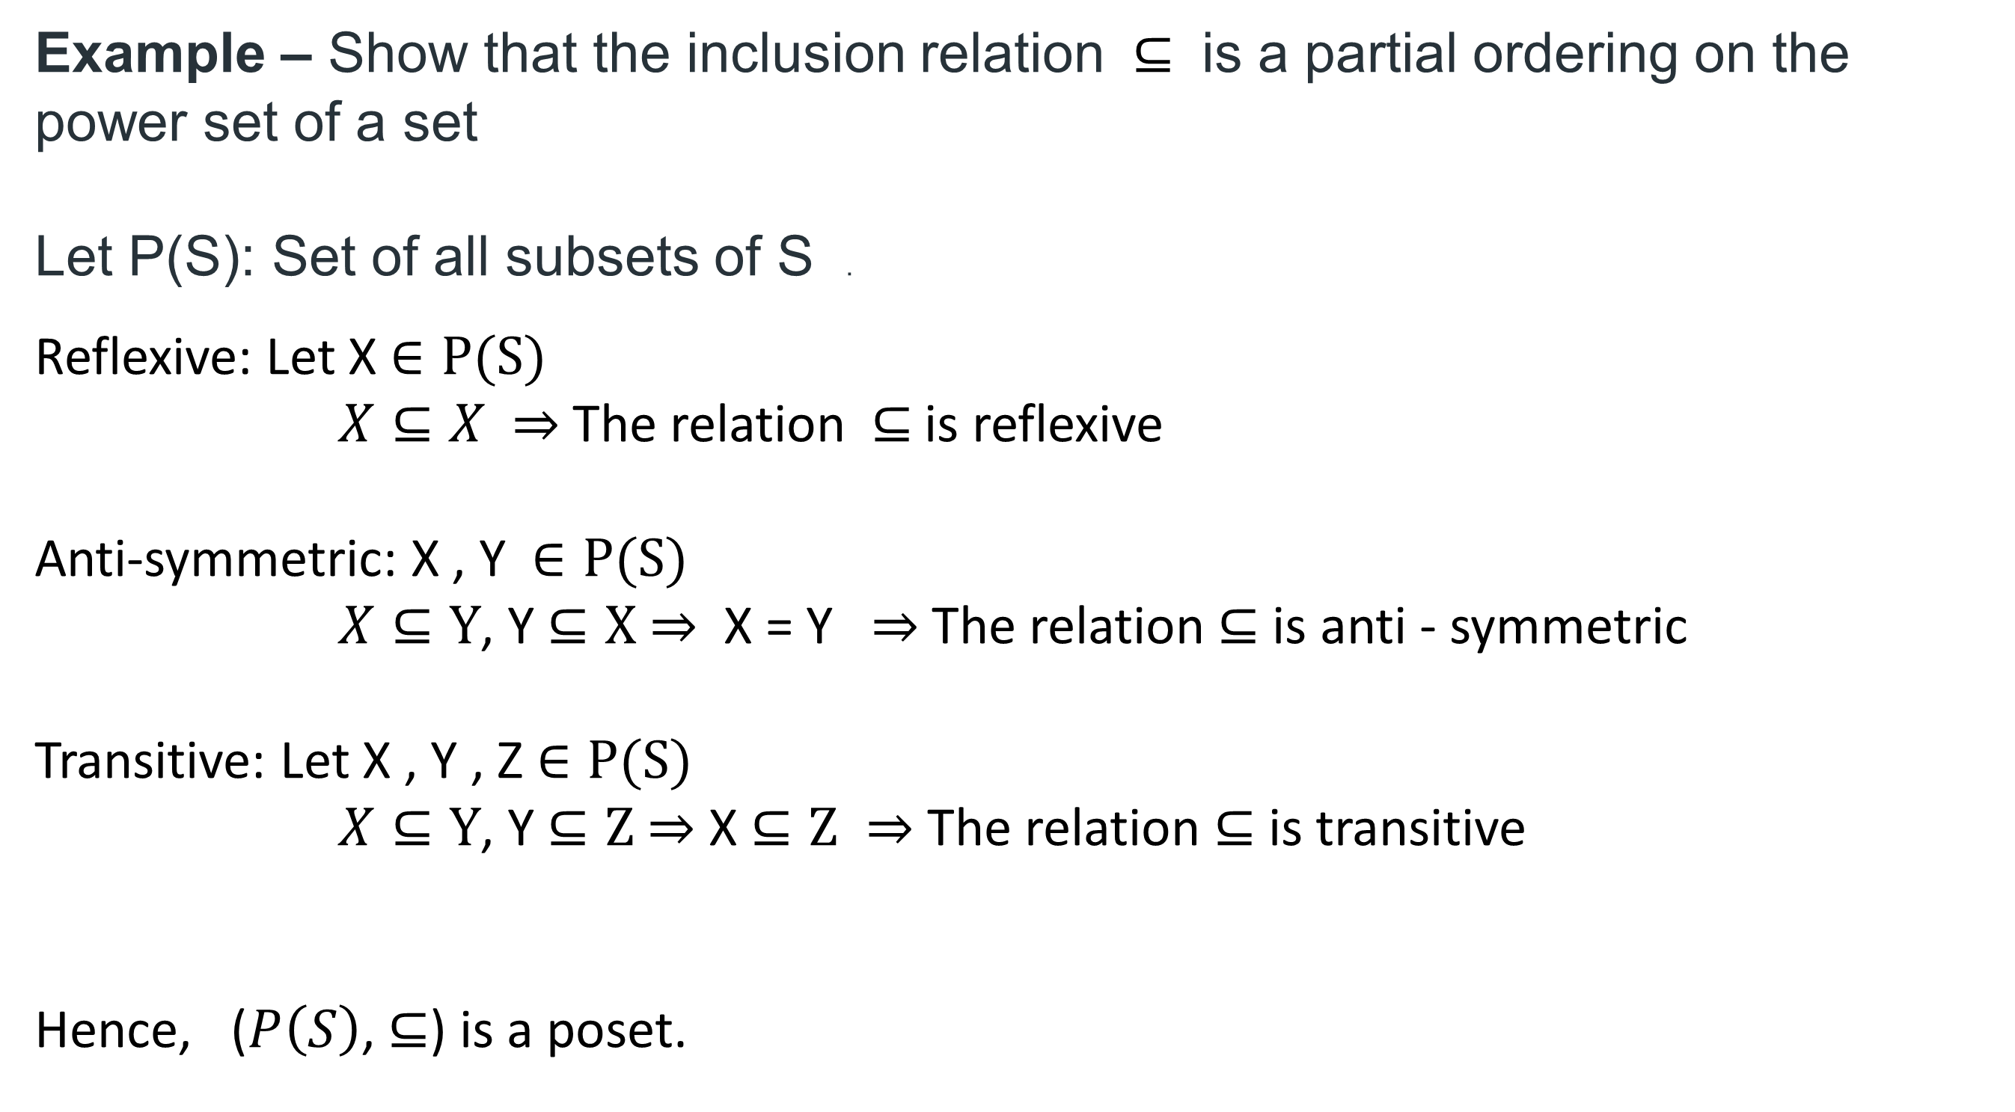
Example – Show that the inclusion relation $⊆$ is a partial ordering on the power set of a set
Let P(S): Set of all subsets of S .
Reflexive: Let X $∈P(S)$
$X⊆X$ $⇒$The relation$⊆$is reflexive
Anti-symmetric: X , Y $∈P(S)$
$X⊆Y$, Y $⊆X$ $⇒$ X = Y $⇒$The relation$⊆$ is anti - symmetric
Transitive: Let X , Y , Z $∈P(S)$
$X⊆Y$, Y $⊆Z$ $⇒$ X $⊆Z ⇒$The relation $⊆$ is transitive
Hence, ($P\left(S\right)$, $⊆$) is a poset.

Slide 5
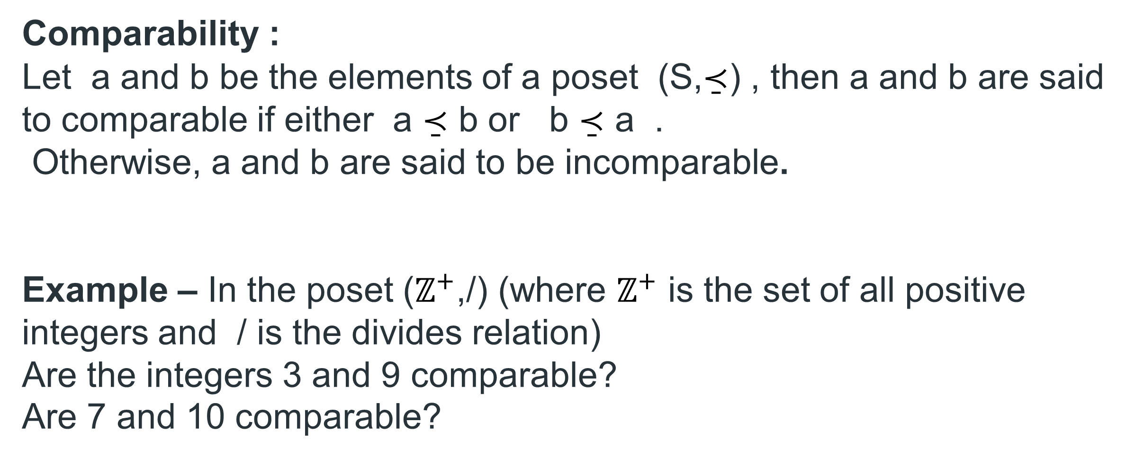
Comparability :
Let a and b be the elements of a poset (S,$\underset{¯}{≺}$) , then a and b are said to comparable if either a $\underset{¯}{≺}$ b or b $\underset{¯}{≺}$ a .
Otherwise, a and b are said to be incomparable.
Example – In the poset ($ℤ^{+}$,/) (where $ℤ^{+}$ is the set of all positive integers and / is the divides relation)
Are the integers 3 and 9 comparable?
Are 7 and 10 comparable?

Slide 6
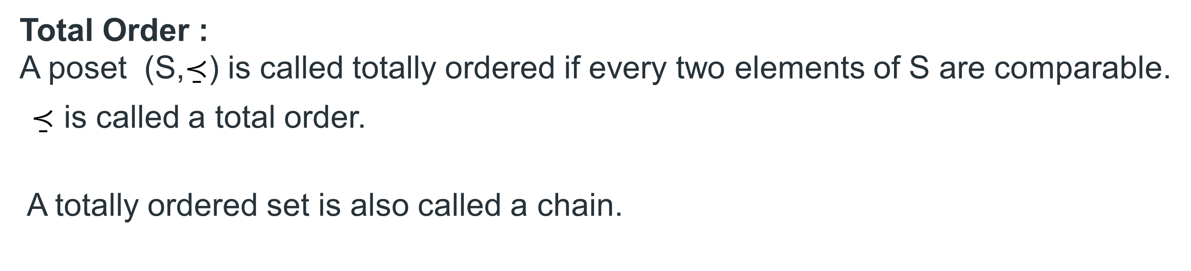
Total Order :
A poset (S,$\underset{¯}{≺}$) is called totally ordered if every two elements of S are comparable. $\underset{¯}{≺}$ is called a total order.
A totally ordered set is also called a chain.

Slide 7
GATE-CS-2006
A relation R is defined on ordered pairs of integers as follows: (x,y) R(u,v) if x < u and y > v. Then R is: Then R is: (A) Neither a Partial Order nor an Equivalence Relation (B) A Partial Order but not a Total Order (C) A Total Order (D) An Equivalence Relation
Answer: (A)

Slide 8
Hasse Diagrams
A Hasse diagram is a graphical representation of the relation of elements of a partially ordered set (poset) with an implied upward orientation.
In the diagram elements represents vertices

Slide 9
a partial order on a finite set can be represented using the following procedure –
Remove all self-loops from all the vertices.
Remove all edges which are present due to transitivity
Arrange all edges such that the initial vertex is below the terminal vertex.
Remove all arrows on the directed edges, since all edges point upwards.

Slide 10
Example: Let X ={1,2,3,4,5,6} and / is a partial order relation on X.
1$\overset{̲}{≺}$1, 1$\overset{̲}{≺}$2 , 1$\overset{̲}{≺}$3 , 1$\overset{̲}{≺}$4, 1$\overset{̲}{≺}$5, 1$\overset{̲}{≺}$6
2$\overset{̲}{≺}$2, 2$\overset{̲}{≺}$4, 2$\overset{̲}{≺}$6
3$\overset{̲}{≺}$3, 3$\overset{̲}{≺}$6
4$\overset{̲}{≺}$4
5$\overset{̲}{≺}$5
6$\overset{̲}{≺}$6
6
4
3
2
5
1

Slide 11
Example: Hasse diagram for (P(S), $⊆$) where S = {a,b,c}
P(S) = {$φ$, {a} , {b} , {c} , {a,b} , {b,c} , {a,c} , {a,b,c}}

Slide 12
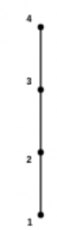
Example: Describe the ordered pairs in the relation determined by Hasse diagram of a poset (S,$\underset{¯}{≺}$) on the set S = {1,2,3,4}
(i)

Slide 13
4
(ii)
3
2
1

Slide 14
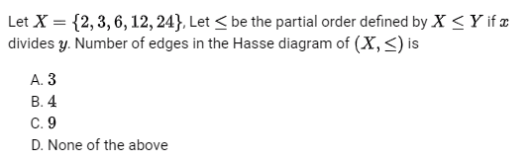
GATE CS 1996
Answer: b

Slide 15
Special Elements in Posets
Let $\left(P,\overset{̲}{≺}\right)$ be a poset. An element a in the poset is called a maximal element of P if a $≺$ x for no x in P.
Similarly, An element b in the poset is called a minimal element of P if x $≺$ b for no x in P.
An element a in the poset is called a greatest element of P if x$\overset{̲}{≺}$ a for all x in P.
The greatest element if it exists, is unique.
An element b in the poset is called a least element of P if b$\overset{̲}{≺}$ x for all x in P.
The greatest element if it exists, is unique.

Slide 16
Example: Hasse diagram for ({3, 4, 12, 24, 48, 72}, /)
Maximal Elements : 48 , 72
Minimal Elements : 3, 4
48
72
24
12
4
3

Slide 17
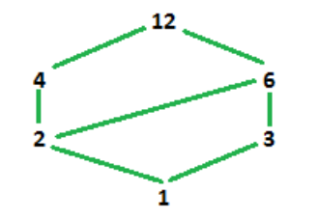
Maximal and Greatest element is 12 and Minimal and Least element is 1.

Slide 18
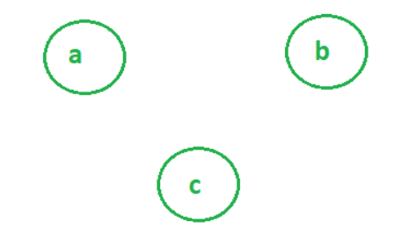
NOTE: An element can be both maximal and minimal
Example-
Here a,b,c are maximal as well as minimal.

Slide 19
Bounds in Posets :
Let B be a subset of poset $\left(A,\overset{̲}{≺}\right)$.
An element $u∈A$ is called upper bound of B if u succeeds every element of B i.e., x $\overset{̲}{≺}$ u for all x $∈$ B.
An element l $∈A$ is called lower bound of B if l precedes every element of B i.e., l$\overset{̲}{≺}x$ for all x $∈$ B.

Slide 20
An element a $∈A$ is called least upper bound of B if
a is an upper bound of B
a$\overset{̲}{≺}a′$ for any upper bound a’ of B.
An element a $∈A$ is called greatest lower bound of B if
a is a lower bound of B
a'$\overset{̲}{≺}a$ for any lower bound a’ of B.

Slide 21
Example – Find the least upper bound and greatest lower bound of the following subsets- {b, c}, {g, e, a}, [e, f}
Upper bounds of {b, c} are e, f, i, h
Least upper bound is e
Lower bound of {b, c} is a
Greatest lower bound is a
(ii) Upper bound of {g, e, a} is h
Least upper bound is h
Lower bound of {g, e, a} is a
Greatest lower bound is a
(iii) Upper bounds of {e, f} are f, i, h
Least upper bound is f
Lower bounds of {e, f } are e, b, c, a
Greatest lower bound is e

Slide 22
Lattices – A Poset in which every pair of elements has both, a least upper bound and a greatest lower bound is called a lattice.
There are two binary operations defined for lattices –
Join – The join of two elements is their least upper bound. It is denoted by $∨$ , not to be confused with disjunction.
Meet – The meet of two elements is their greatest lower bound. It is denoted by $∧$ , not to be confused with conjunction
a $∨$ b = l.u.b. {a, b}
a $∧$ b = g.l.b. {a, b}

Slide 23
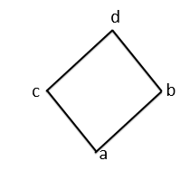
d
e
c
a
b

Slide 24
Example: Given Hasse Diagram is a lattice

Slide 25
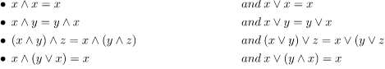
Sub Lattice – A sublattice S of lattice L is a subset S of L such that if a,b $∈$ S,
a $∨$ b $∈$ S and a $∧$ b $∈$ S.
Identities for join and meet –

Slide 26
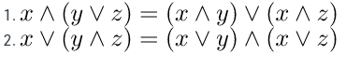
Distributive laws may or may not hold true for a lattice :
A lattice is called a distributive lattice if the distributive laws hold for it.

Slide 27
GATE-CS-2004
The inclusion of which of the following sets into
S = {{1, 2}, {1, 2, 3}, {1, 3, 5}, (1, 2, 4), (1, 2, 3, 4, 5}}
is necessary and sufficient to make S a complete lattice under the partial order defined by set containment ? (A) {1} (B) {1}, {2, 3} (C) {1}, {1, 3} (D) {1}, {1, 3}, (1, 2, 3, 4}, {1, 2, 3, 5)
Answer: (A)

Slide 28
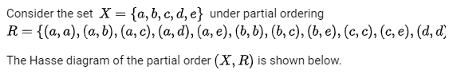
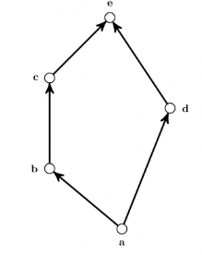
GATE-CS-2017
The minimum number of ordered pairs that need to be
added to R to make (X,R) a lattice is ______
Answer: 0

Slide 29

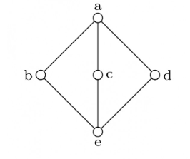
GATE-CS-2005
The poset is :
not a lattice
a lattice but not a distributive lattice
a distributive lattice but not a Boolean algebra
a Boolean algebra
L.H.S. = b ^ (c V d) = b ^ a = b
R.H.S. = (b^c) V (b^d) = e v e = e
Answer: (B)

Slide 30
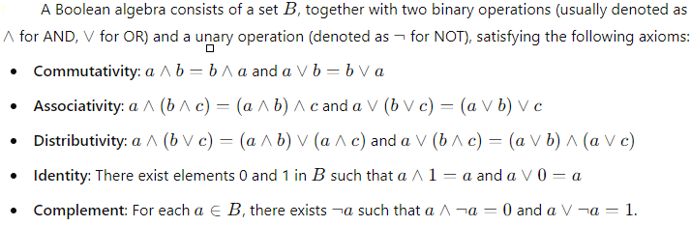

Slide 31
Groups
BINARY OPERATION
Thus, the binary operation on set A can be defined as a function is given by *: A $×$ A → A.
So the operation * performed on operands a and b is denoted by a * b.

Slide 32
Algebraic Structure
A non empty set S w.r.t binary operation (*) is called an algebraic structure
Example : S = {1,-1} is algebraic structure under $×$

Slide 33
Semi Group
A non-empty set S, (S,*) is called a semigroup if it follows the following axiom:
Closure:(a*b) belongs to S for all a,b ∈ S.
Associativity: a*(b*c) = (a*b)*c ∀ a,b,c belongs to S.
Ex : (Set of integers, +), and (Matrix ,*) are examples of semigroup.

Slide 34
Monoid
A non-empty set S, (S,*) is called a monoid if it follows the following axiom:
Closure:(a*b) belongs to S for all a,b ∈ S.
Associativity: a*(b*c) = (a*b)*c ∀ a,b,c belongs to S.
Identity Element: There exists e ∈ S such that a*e = e*a = a ∀ a ∈ S
Ex :
(Set of integers, +), and (Matrix ,*) are examples of monoid.
N = {0, 1, 2, . . .} is a monoid with respect to addition.

Slide 35
Group
A non-empty set G, (G,*) is called a group if it follows the following axiom:
Closure:(a*b) belongs to G for all a,b ∈ G.
Associativity: a*(b*c) = (a*b)*c ∀ a,b,c belongs to G.
Identity Element:There exists e ∈ G such that a*e = e*a = a ∀ a ∈ G
Inverses:∀ a ∈ G there exists a⁻¹ ∈ G such that a*a⁻¹ = a⁻¹*a = e

Slide 36
Abelian Group or Commutative group
A non-empty set S, (S,*) is called a Abelian group if it follows the following axiom:
Closure:(a*b) belongs to S for all a,b ∈ S.
Associativity: a*(b*c) = (a*b)*c ∀ a,b,c belongs to S.
Identity Element:There exists e ∈ S such that a*e = e*a = a ∀ a ∈ S
Inverses:∀ a ∈ S there exists a⁻¹ ∈ S such that a*a⁻¹ = a⁻¹*a = e
Commutative: a*b = b*a for all a,b ∈ S

Slide 37
$ℤ$ is a group under addition.
$ℤ$ is not a group under multiplication.
$ℝ$\{0} is a group under multiplication.

Slide 38
$\left.M_{2}(ℝ\right)$ (set of matrices) is a group under addition.
$\left.M_{2}(ℝ\right)$ is not a group under multiplication.

Slide 39
$\left.{GL}_{2}(ℝ\right)$ = $\left\{A∈M_{2}\left(ℝ\right) : det(A)≠0\right\}$ is a group under multiplication.

Slide 40
G = $\left\{1,−1,i,−i\right\}$ is a group under multiplication.
NOTE : If G is a finite group with the operation *, the Cayley table of G is a table with rows and columns labeled by the elements of the group. The entry in the table describes the operation

Slide 41
The set $Z_{n}$ = {0, 1, 2,..., n − 1} for n ≥ 1 is a group under addition modulo n.
This group is usually referred to as the group of integers modulo n.

Slide 42
GATE-CS-2009
Which one of the following in NOT necessarily a property of a Group? (A) Commutativity (B) Associativity (C) Existence of inverse for every element (D) Existence of identity
Answer: (A)

Slide 43
GATE CSE 2019
Let G be an arbitrary group. Consider the following relations on G :
R₁: ∀a,b ∈ G, aR₁b if and only if ∃g ∈ G such that a = g⁻¹bg R₂: ∀a,b ∈ G, aR₂b if and only if a = b⁻¹
Which of the above is/are equivalence relation/relations?
R1 and R2
R1 only
R2 only
Neither R1 nor R2
Answer: (B)

Slide 44
Reflexive: $a=g^{−1}ag$ can be satisfied by putting g = e, identity “e” always exists in a group.
Symmetric:
aRb ⇒ $a=g^{−1}bg$for some g
⇒ $a=gag^{−1}$ = $a={\left(g^{−1}\right)}^{−1}ag^{−1}$
Transitive: aRb and bRc
⇒ $a=g_{1}^{−1}bg_{1}$ and b = $a=g_{2}^{−1}bg_{2}$ for some $g_{1},g_{2}$∈ G.
Now $a=g_{1}^{−1}g_{2}^{−1}cg_{2}g_{1}$ = $a={\left(g_{2}g_{1}\right)}^{−1}cg_{2}g_{1}$
$g_{1}$ ∈ G and $g_{2}$ ∈ G ⇒ $g_{2}g_{1}$ , ${\left(g_{2}g_{1}\right)}^{−1}$ ∈ G (Since G is a group)
so aRb and aRb ⇒ aRc

Slide 45
GATE CSE 2013
A Binary operation ⊕ on a set of integers is defined as x ⊕ y = x² + y². Which one of the following statements is TRUE about ⊕ ? (A) Commutative but not associative (B) Both commutative and associative (C) Associative but not commutative (D) Neither commutative nor associative
Answer: (A)

Slide 46
GATE-CS-2005
The set {1, 2, 4, 7, 8, 11, 13, 14} is a group under multiplication modulo 15. The inverses of 4 and 7 are respectively
(A) 3 and 13 (B) 2 and 11 (C) 4 and 13 (D) 8 and 14
Answer: (C)

Slide 47
GATE-CS-2006
The set {1, 2, 3, 5, 7, 8, 9} under multiplication modulo 10 is not a group. Given below are four plausible reasons. Which one of them is false? (A) It is not closed (B) 2 does not have an inverse (C) 3 does not have an inverse (D) 8 does not have an inverse
Answer: (C)

Slide 48
GATE CSE 1994
Some group (G, o ) is known to be abelian. Then, which one of the following is true for G?
g =$g^{−1}$ for every g ∈ G
g =$g^{2}$ for every g ∈ G
${(goh)}^{2}$=$g^{2}$o$h^{2}$ for every g, h ∈ G
G is of finite order
Answer: (C)

Slide 49
GATE-CS-2004
The following is the incomplete operation table a 4-element group.
The last row of the table is (A) c a e b
(B) c b a e (C) c b e a (D) c e a b
Answer (D)
* | e | a | b | c
e | e | a | b | c
a | a | b | c | e
b
c

Slide 50
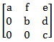
GATE-CS-2005
Consider the set H of all 3 × 3 matrices of the type
where a, b, c, d, e and f are real numbers and abc ≠ 0. Under the matrix multiplication operation, the set H is (A) a group (B) a monoid but not a group (C) a semigroup but not a monoid (D) neither a group nor a semigroup

Slide 51
Order of an element and Group
Order of a Group
The number of elements of a group (finite or infinite) is called its order. We denote the order of G by |G|.

Slide 52
Example : (i) G = { 1, -1, i, -i }
(ii) $G=ℤ$

Slide 53
Order of an Element
The order of an element g in a group G is the smallest positive integer n such that $g^{n}$ = e (ng = 0 in additive notation).
If no such integer exists, we say g has infinite order. The order of g is denoted by |g|.
G = { 1, -1, i, -i }
$$G=ℤ$$

Slide 54
$$\left.Example: G=\{a,a^{2},a^{3},a^{4},a^{5},a^{6}=e\right\}$$

Slide 55
Example : Order of elements in the group $Z_{12}$

Slide 56
Subgroups
Subgroup
If a subset H of a group G is itself a group under the operation of G, we say that H is a subgroup of G.
If H is a proper subset of G, then H is a proper subgroup of G.
{e} is the trivial subgroup of G.
If H $≠$ {e} then H is called nontrivial subgroup.

Slide 57
Example: $G=ℤ$
H = set of even integers
K = set of odd integers
Example: $Z_{5}$ is not a subgroup of $ℤ$.

Slide 58
Two-step subgroup test
A nonempty subset of a group is itself a group if the subset is closed under the operation as well as under the taking of inverses.
Example: If G is an Abelian group then H = {x | $x^{2}$ = e} ≤ G

Slide 59
Lagrange’s Theorem
Let G be a finite group and let H be a subgroup. Then the order of H divides the order of G.
Example: Let H and K be a subgroup of G
(i) |G| = 24
|H| can be 1,2,3,4,6,8,12,24
(ii) |H| = 7
|G| = 7k , $k∈ℕ$

Slide 60
GATE-CS-2014-(Set-3)
Let G be a group with 15 elements. Let L be a subgroup of G. It is known that L $≠$ G and that the size of L is at least 4. The size of L is __________. (A) 3 (B) 5 (C) 7 (D) 9
Answer: (B)

Slide 61
Fundamental theorem for finite abelian groups
The number of abelian groups of order $n=p_{1}^{n_{1}}....p_{k}^{n_{k}}$ is the product of the partition numbers of $n_{i}$.
Example: |G| = 12
12 = $2×2×3$ = $2^{2}×3$
Partitions of 2 are 2, 1+1
Partition of 1 is 1
Number of abelian groups of order 12 = $2×1$ = 2

Slide 62
GATE CSE 2007
How many different non-isomorphic Abelian groups of order 4 are there?
2
3
4
5
Answer (A)

Slide 63
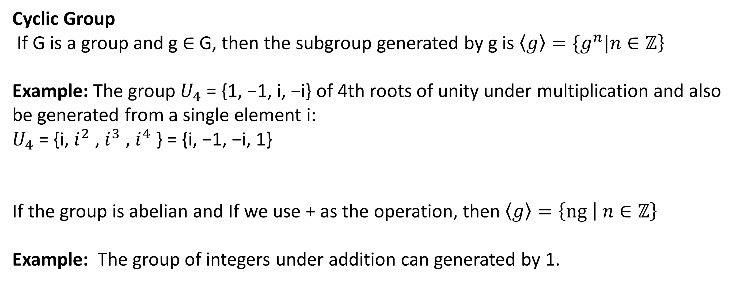
Cyclic Group
If G is a group and g ∈ G, then the subgroup generated by g is $\left.〈g〉=\{g^{n}|n∈ℤ\right\}$
Example: The group $U_{4}$ = {1, −1, i, −i} of 4th roots of unity under multiplication and also be generated from a single element i:
$U_{4}$ = {i, $i^{2}$ , $i^{3}$ , $i^{4}$ } = {i, −1, −i, 1}
If the group is abelian and If we use + as the operation, then $\left.〈g〉=\left\{ng \right| n∈ℤ\right\}$
Example: The group of integers under addition can generated by 1.

Slide 64
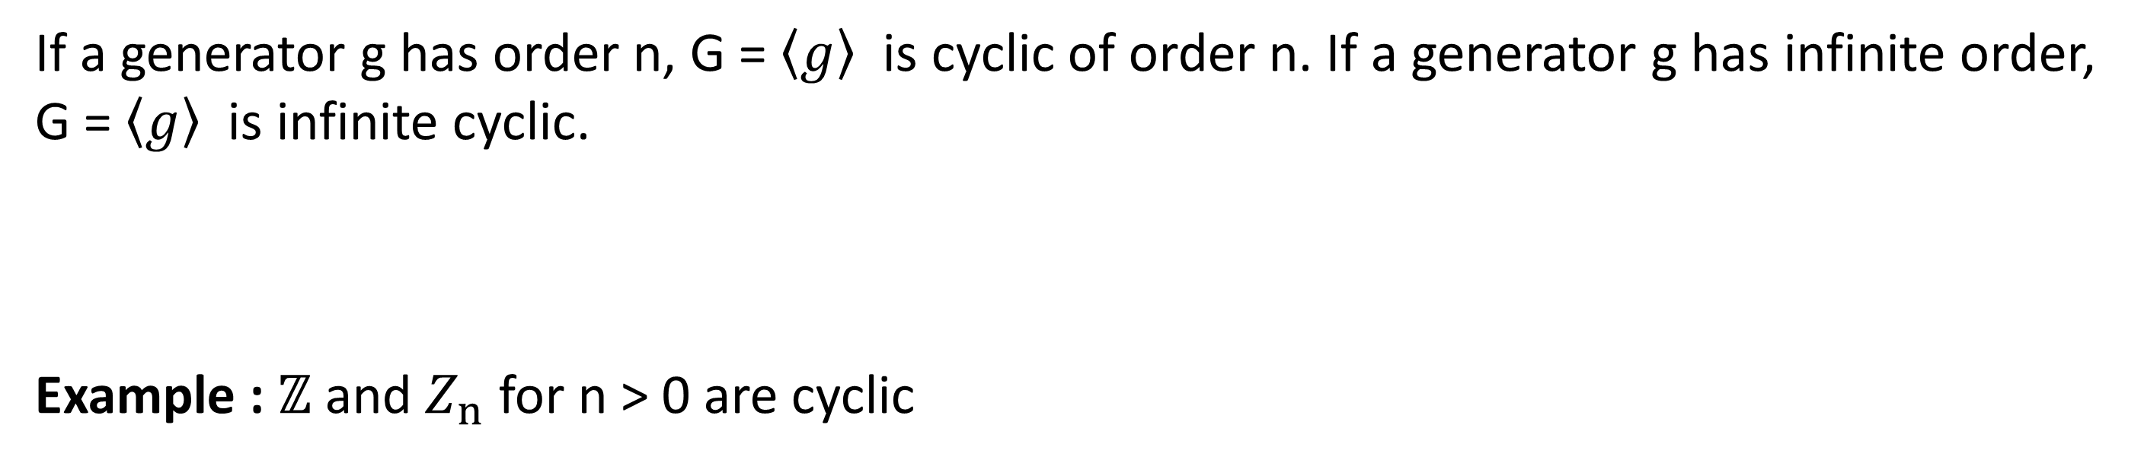
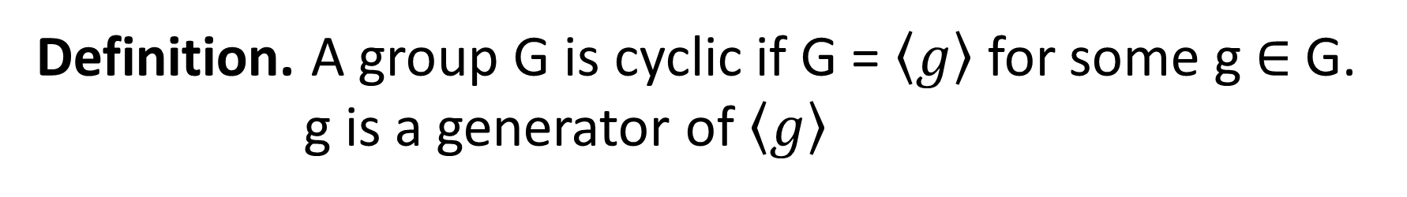
Definition. A group G is cyclic if G = $〈g〉$ for some g ∈ G.
g is a generator of $〈g〉$
If a generator g has order n, G = $〈g〉$ is cyclic of order n. If a generator g has infinite order, G = $〈g〉$ is infinite cyclic.
Example : $ℤ$ and $Z_{n}$ for n > 0 are cyclic

Slide 65
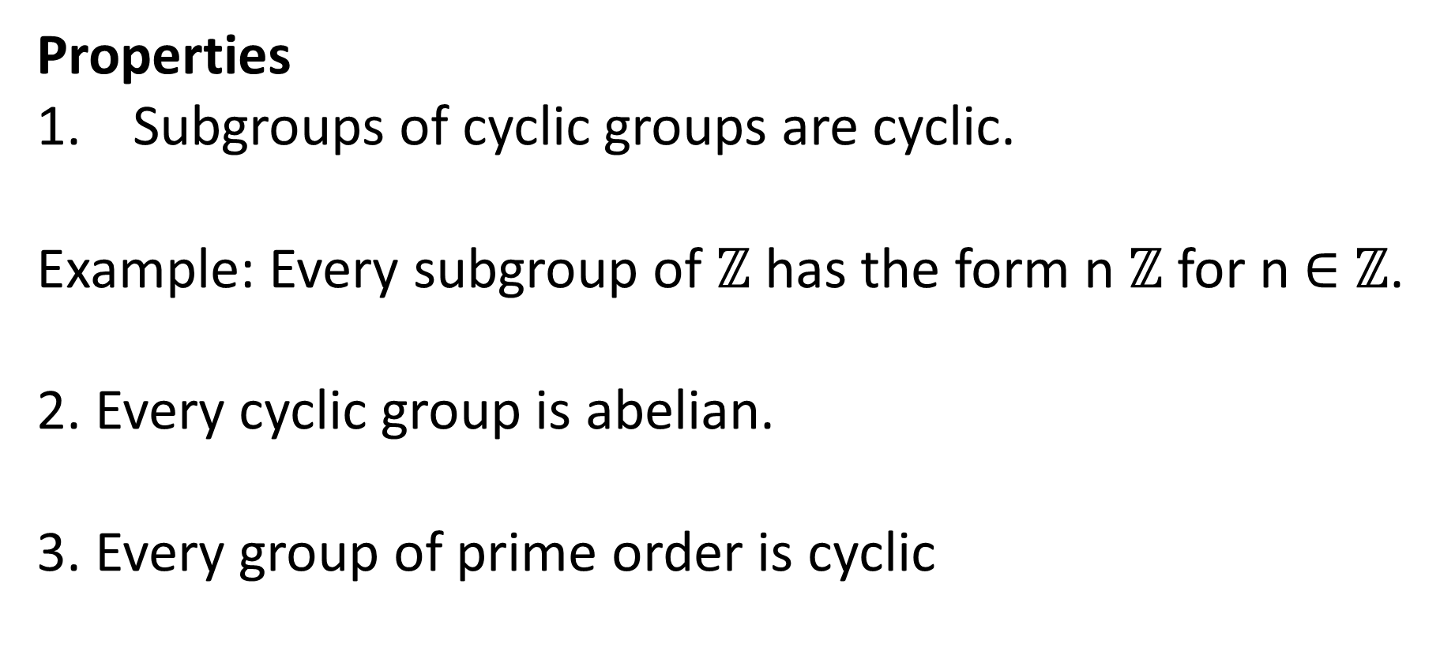
Properties
Subgroups of cyclic groups are cyclic.
Example: Every subgroup of $ℤ$ has the form n $ℤ$ for n ∈ $ℤ$.
2. Every cyclic group is abelian.
3. Every group of prime order is cyclic

Slide 66
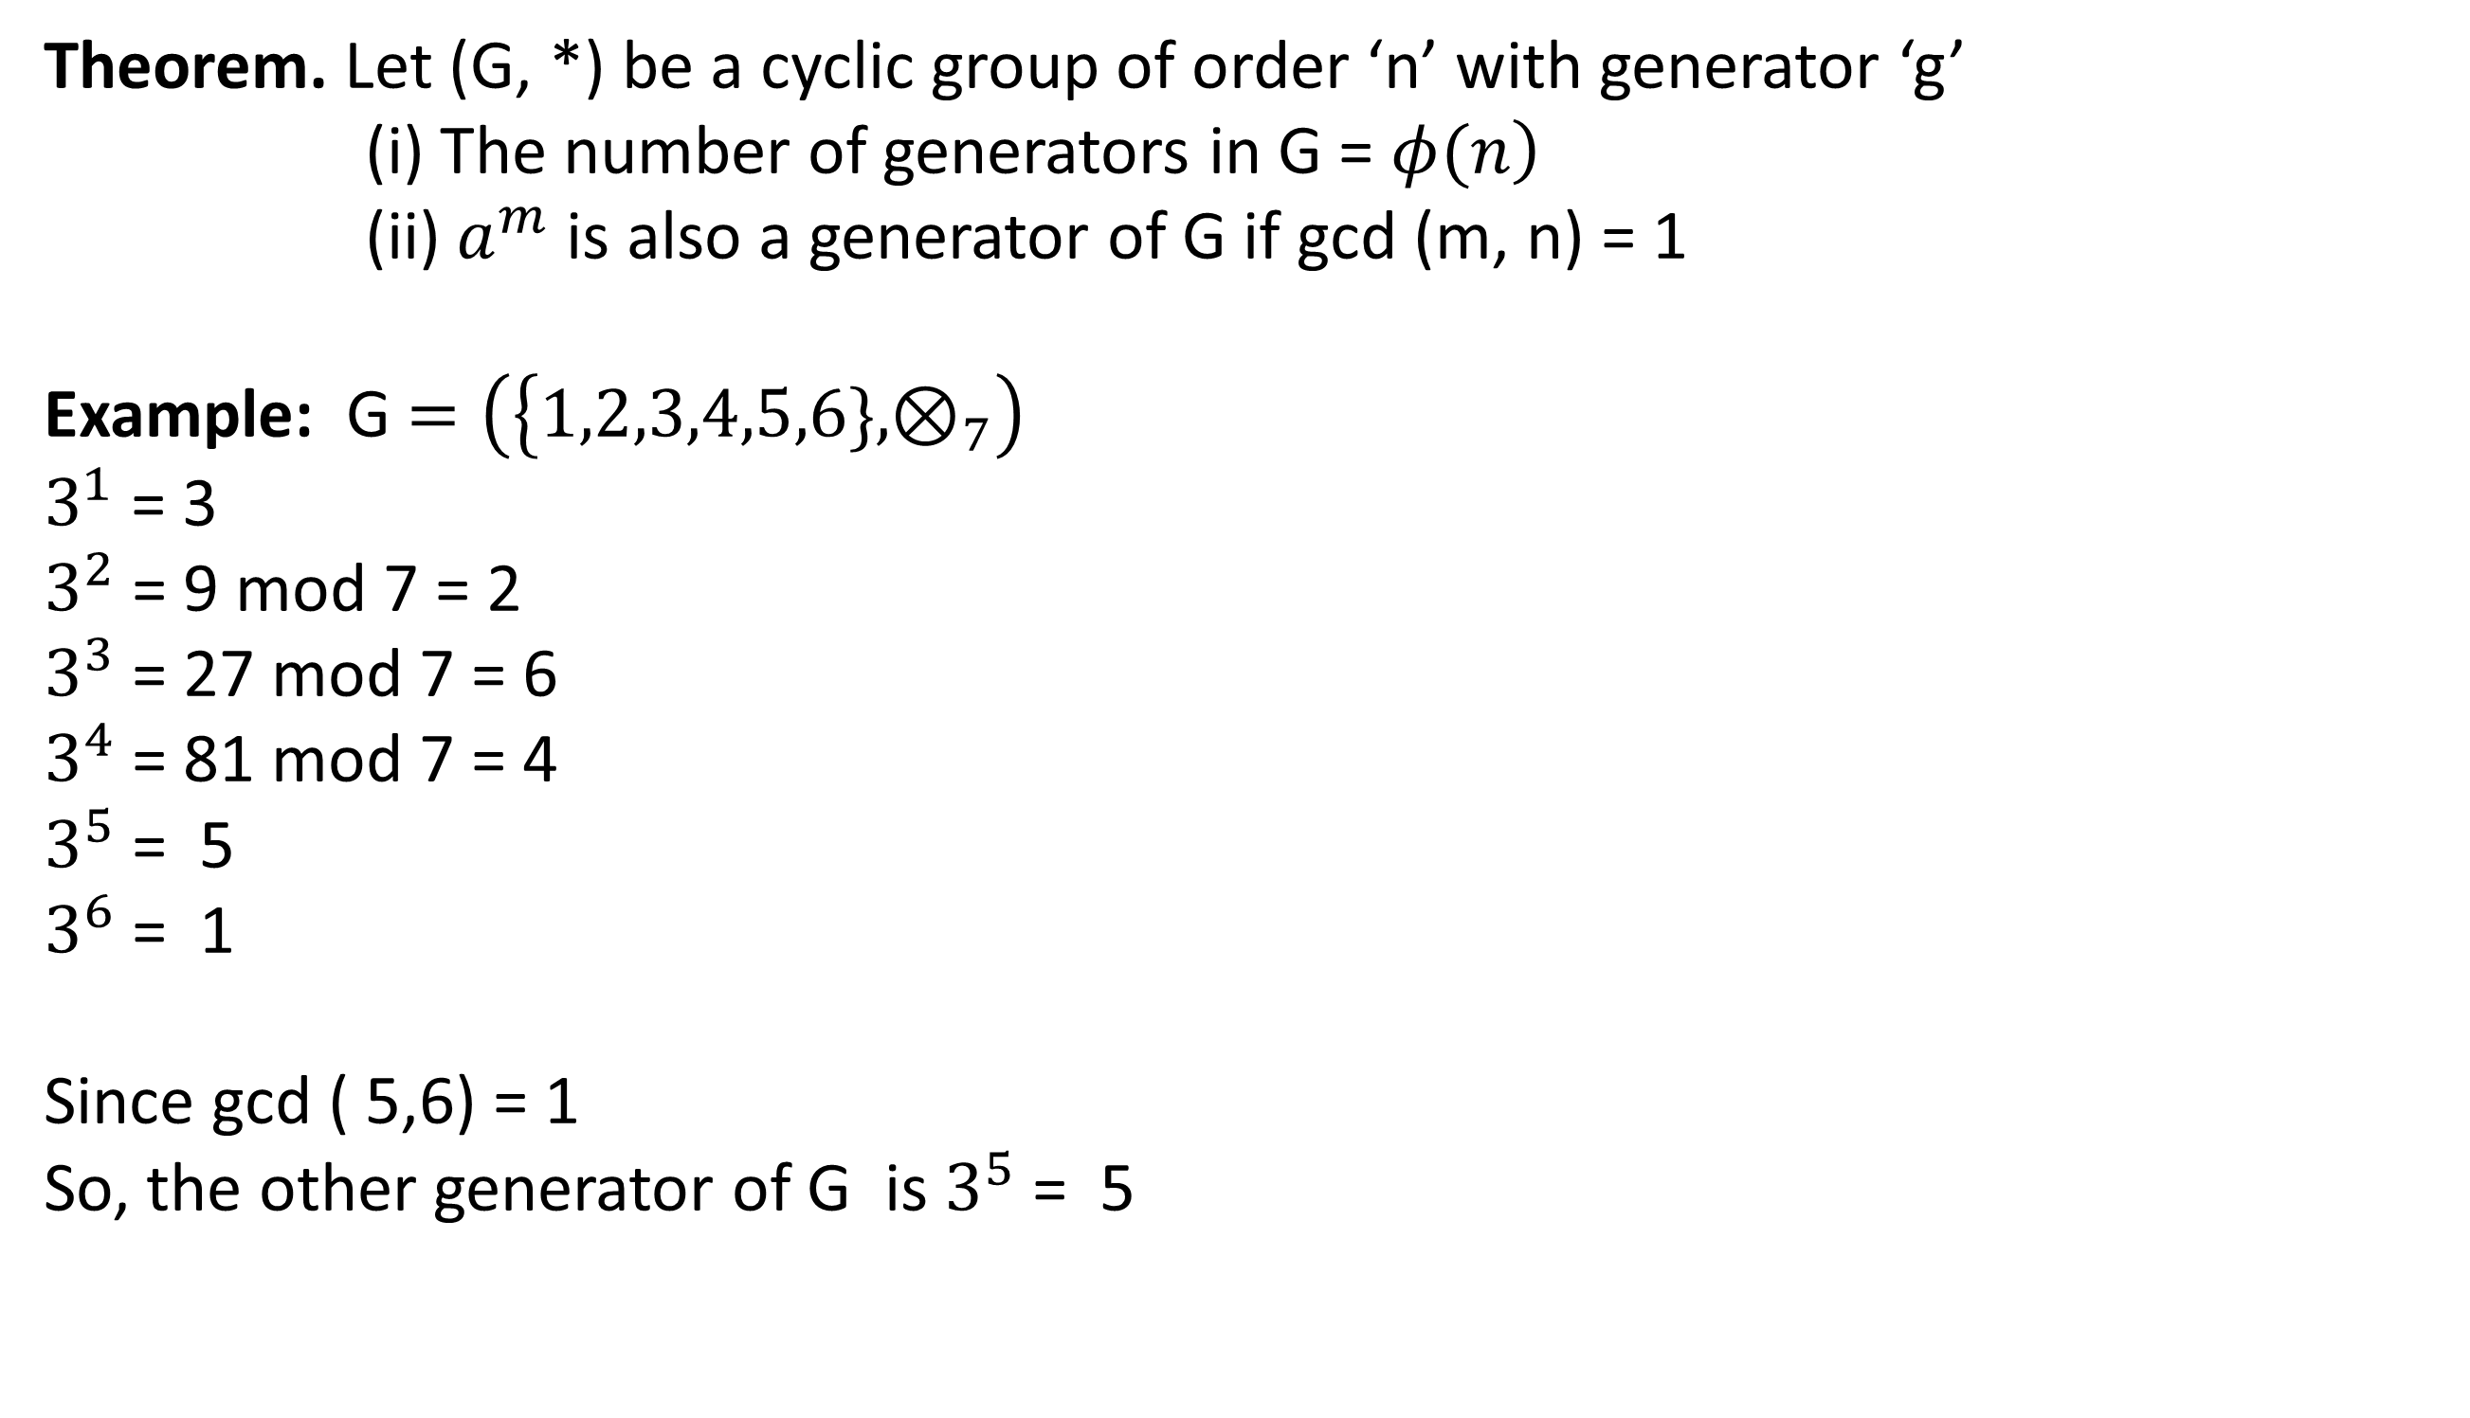
Theorem. Let (G, *) be a cyclic group of order ‘n’ with generator ‘g’
(i) The number of generators in G = $\left.φ(n\right)$
(ii) $a^{m}$ is also a generator of G if gcd (m, n) = 1
Example: G $=\left(\left\{1,2,3,4,5,6\},⊗_{7}\right.\right)$
$3^{1}$ = 3
$3^{2}$ = 9 mod 7 = 2
$3^{3}$ = 27 mod 7 = 6
$3^{4}$= 81 mod 7 = 4
$3^{5}$ = 5
$3^{6}$ = 1
Since gcd ( 5,6) = 1
So, the other generator of G is $3^{5}$ = 5

Slide 67
GATE CSE 2020
Let G be a group of 35 elements. Then the largest possible size of a subgroup of G other than G itself is ______.

Slide 68
GATE CSE 2014 Set 3
There are two elements x,y in a group (G,∗) such that every elements in the group can be written as a product of some number of x′s and y′s in some order. It is known that x∗x=y∗y=x∗y∗x∗y=y∗x∗y∗x=e where e is the identity element. The maximum number of elements in such a group is _____.
Solution: x∗y=x∗e∗y=x∗(x∗y∗x∗y)∗y=(x∗x)∗y∗x∗(y∗y)=e∗y∗x∗e=y∗x
 | e | x | y | x*y
e
x
y
x*y

Slide 69
GATE CS 1996
Which of the following statement is false? (A) The set of rational numbers is an abelian group under addition (B) The set of integers is an abelian group under addition (C) The set of rational numbers form an abelian group under multiplication (D) The set of real numbers excluding zero is an abelian group under multiplication
Answer: (C)

Slide 70

Thank you

